Slide 1
Asset Management System

Slide 2
Content
Key Facets of the project.
Team Members and their role.
Application Features.
UI Screenshots.
Highlights of what we learned.

Slide 3
Key facets of the project
User Registration and Authentication:
User Registration: Users should be able to create accounts by providing basic information such as name, email, telephone number, role and password.
User Login: User can enter username password.
User Roles and Permissions:
Define user roles such as regular users and administrators.
(e.g., borrowing assets, adding categories).
Asset CataLog:
Maintain a catalog of all available assets, including their unique identifiers, names, descriptions, and current availability status.

Slide 4
Key facets of the project
Asset Categories:
Allow administrators to add, asset categories to organize assets efficiently (e.g., laptops,mobile, books).
Asset Borrowing:
Enable users to browse the catalog and borrow assets.
Borrowing Period and Due Dates:
Set a specific return period (e.g., 14 days) for each borrowed asset.
Automatically calculate and display due dates to remind users when assets need to be returned.

Slide 5
Key facets of the project
Asset Availability Status:
Update the availability status of assets in real-time as they are borrowed or returned.
Prevent users from borrowing assets that are already checked out.
Admin Dashboard:
Provide administrators with a dashboard to manage asset

Slide 6
Team members and their role:
Divide frontend and backend in 7 team members
Frontend: Ishwari Pandit, Mansi Keshattiwar, Nayan Rathi.
Backend: Ishwar Parmar, Pratiksha Pote,Aparajita,Asif.

Slide 7
Application Features
User Registration and Authentication
User Roles and Permissions
Asset Catalog
Add Asset Categories
Asset Borrowing
Borrowing Period and Due Dates
Asset Availability Status
Admin Dashboard
Search and Filter Functionality

Slide 8
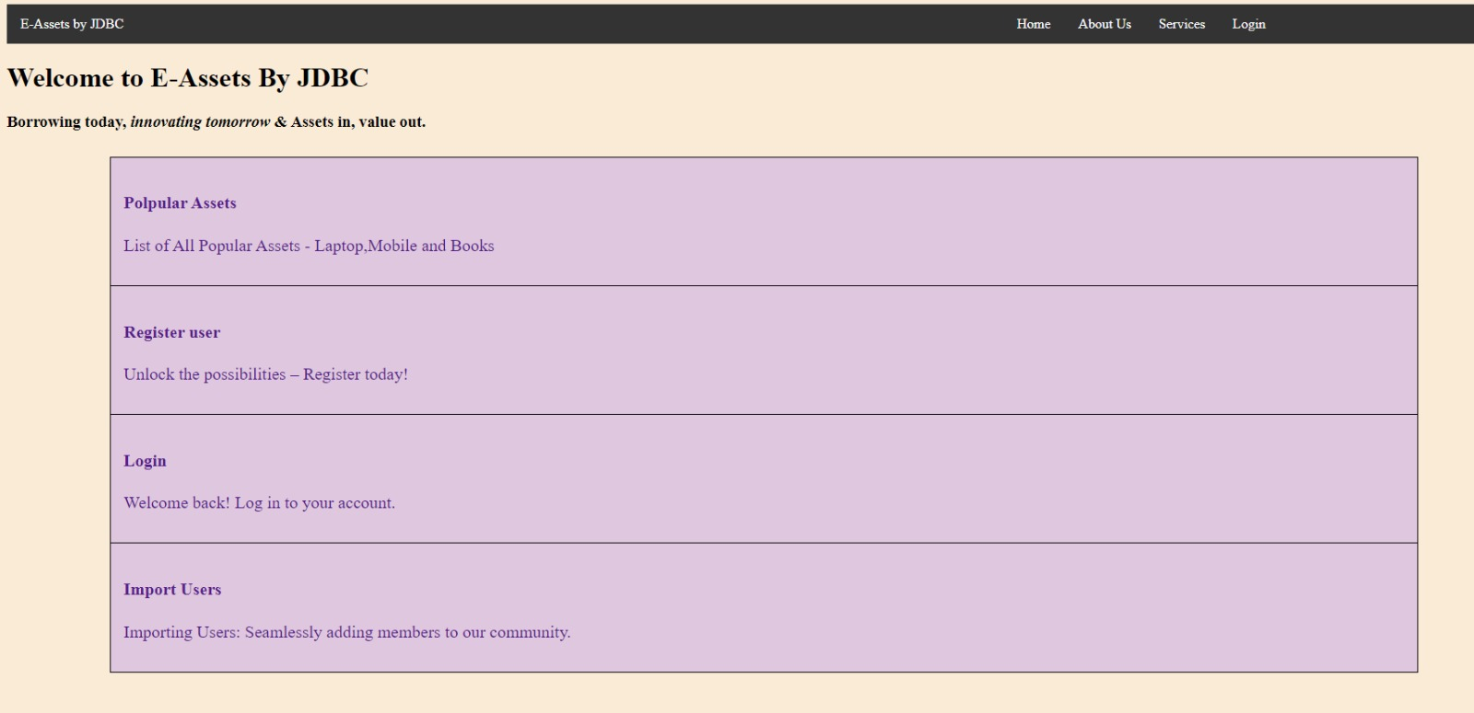
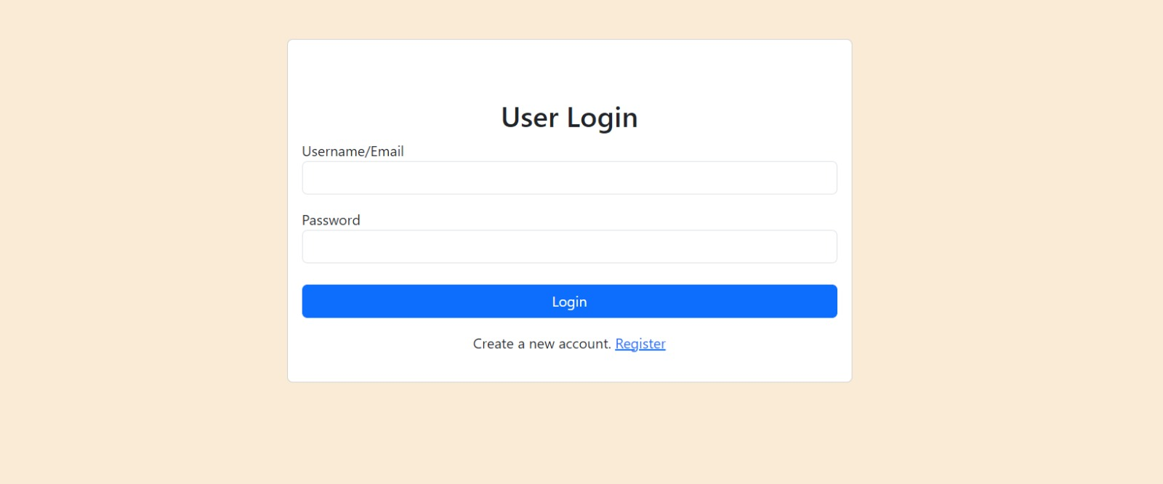
UI Screenshots
1. Home Page
2.Login Page

Slide 9
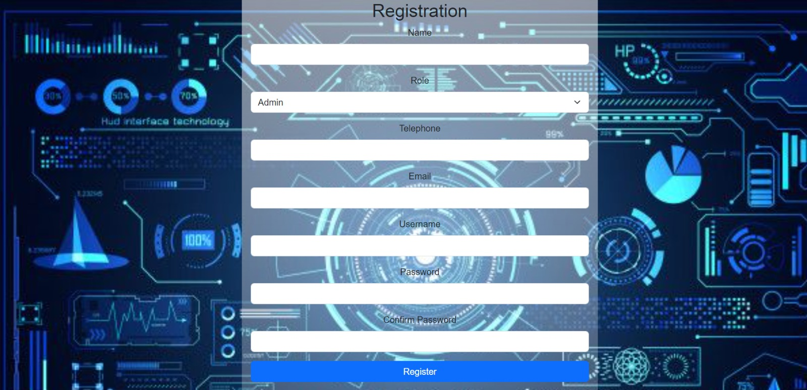
3.Registration Page

Slide 10
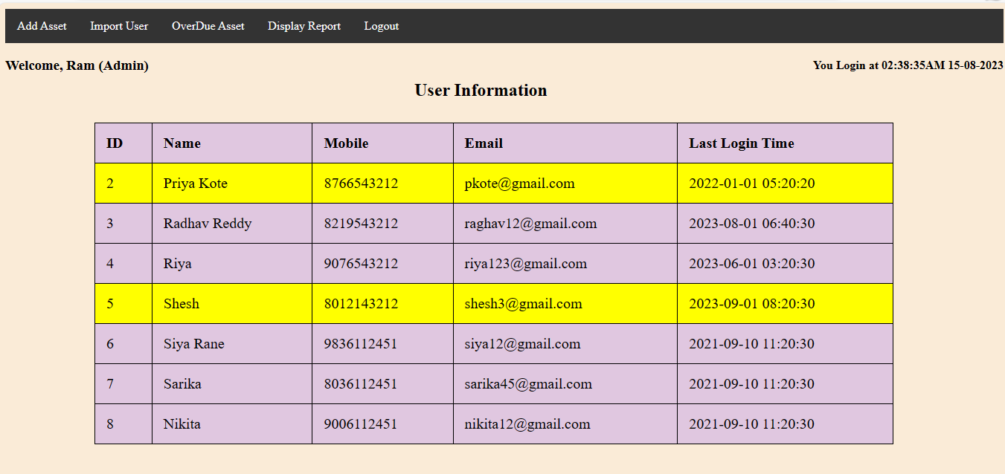
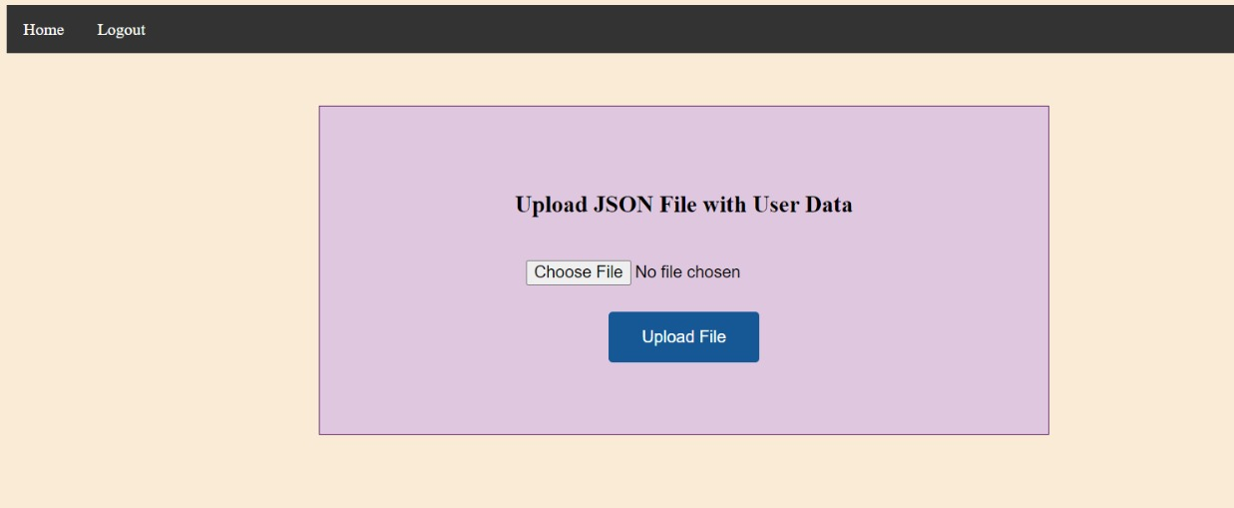
5.Import Users
4.Admin Home Page

Slide 11
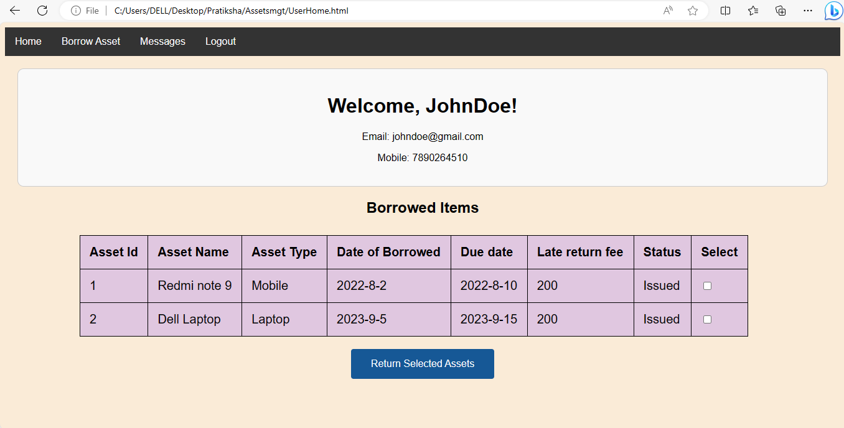
User Home Page

Slide 12
Highlights of what we learned
Asset Management Concepts:
Understanding the fundamentals of asset borrowing, categorization, Displaying Catlog.
User Requirements Gathering:
Learning how to collect and document user requirements, which are crucial for designing a system that meets the needs of stakeholders.
Database Design:
Designing a database schema to store asset information efficiently, including tables for assets, users, categories, and transaction history.

Slide 13
Highlights of what we learned
Programming and Development:
Gaining proficiency in programming languages and frameworks to develop the asset management system. This could involve languages like Java, web development technologies like HTML, CSS, and JavaScript
User Interface (UI) Design:
Creating an intuitive and user-friendly interface for the system, considering principles of usability and accessibility.
Collaboration and Communication:
Developing collaboration skills by working with team members to gather requirements, provide updates, and address feedback.

Slide 14
Highlights of what we learned:
Project Management:
Learning project management methodologies and tools to plan, schedule, and track progress effectively.
Testing and Quality Assurance:
Conducting thorough testing of the system to identify and fix bugs, ensuring that it meets the specified requirements and is free of critical issues.

Slide 15


